Slide 1
CALL CENTER ANALYSIS
TEAM MEMBERS
K.NIKHIL[9921004374]
K.V.S.SAI RAM SANTOSH BABU[9921004355]
D. HARI TEJASWAR REDDY[99210041032]

Slide 2
Abstract
This project aims to develop a data warehouse solution for call center analytics and customer service improvement using ETL tools to extract data, data warehousing for data storage, and Power BI for data visualization and analysis.
Introduction
Developing a data warehouse for call center analytics and customer service improvement involves gathering and integrating data from various sources into a central repository, transforming it into a structured format, and using visualization tools like Power BI to analyze and gain insights from the data.
ETL (Extract, Transform, Load) is a common process used to integrate data from disparate sources into a data warehouse
Data warehousing is the process of designing and building a data warehouse.

Slide 3
Literature Survey
Ref No | Title of the Paper | Author | Published Year | Method | Data Set
1. | Analysis of Call-Center Operation Data Using Role Hierarchy Miner. | Sompong Wongvigran | 2015 | Machine Learning Algorithm (Hierarchy Miner) | Call-Center event log data.
2. | Intelligent decision making and planning for call center. | Islamabad | 2019 | Customer Service Reprehensive (CSR) and Machine Learning Algorithm (k-Means Clustering) | Call Center customer service data.
3. | Call Center performance Evaluate Using Big Data Analysis. | Betul Karakus | 2016 | Machine Learning Algorithm (Cosine and n-gram) and Hadoop | Call-Center data.
4. | Analysis of Handover of Work in Call Center using Social Network Process Mining Technique. | Patcharin Panpanich | 2015 | Handover of Work (Social Network Miner) | Call-Center event log data.
5. | Machine Learning-based Silence Detection in Call Center Telephone Conversation | Leonardo O. Iheme | 2019 | Machine Learning Algorithm (Clustering) and Deep Learning-Based applied to VAD. | Call-Center data.

Slide 4
Materials and Methods
Data Source: - call center dataset | Kaggle
ETL Processing: -
ETL processes involve extracting data from various sources, transforming it into a common format, and loading it into the data warehouse. This step can be performed using ETL tools like SSMS and the data can be extracted by using SSIS
Data Warehousing: -
Once the data is transformed and loaded, it needs to be organized into a structured format that is optimized for reporting and analysis. This is done using data warehousing tools like Microsoft SQL Server Management studio (SSMS)

Slide 5
Data Visualization: -
Data visualization tools like Microsoft Power BI, Tableau, or QlikView can be used to create interactive dashboards and reports that provide insights into call center performance and customer satisfaction. These tools allow users to easily slice and dice data, identify trends and patterns, and generate actionable insights

Slide 6
Data Set Details: -
The dataset consists of call center data with following variables
Variable | Description
Call Id | Unique id
Date | Date of call received
Agent | Call received Agent
Department | Department of Agent
Answered | Call Answered or Not
Resolved | Call Resolved or Not
Speed of Answer | Speed of answering call
Avg Talk Duration | Call Duration
Satisfaction rating | Rating given by customers

Slide 7
Proposed System
Finding Dataset From Kaggle
Pre-processing the data Using Python
Preform ETL process using SSIS and SSMS
Perform Data warehousing Using SSMS
Visualization using Power BI

Slide 8
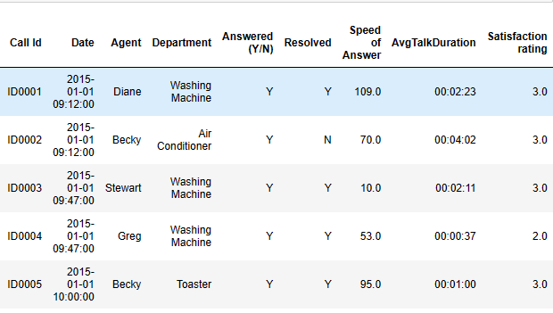
Implementation and Results
Data Pre-Processing: -
Data pre-processing is an important step in the data mining proceing null data using python
import pandas as pd
data=pd.read_excel("C://Users//venka//Downloads//Call Center Dataset 1.xlsx")
data.head()

Slide 9
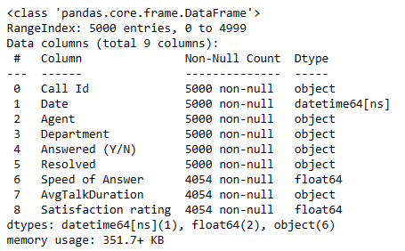
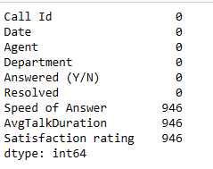
data.isnull().sum()
data.info

Slide 10
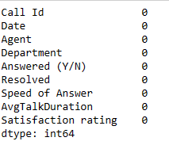
data['Speed of Answer']=data['Speed of Answer'].fillna(data['Speed of Answer'].median()) data['Satisfaction rating']=data['Satisfaction rating'].fillna(data['Satisfaction rating'].median()) data['AvgTalkDuration']=data['AvgTalkDuration'].fillna(data['AvgTalkDuration'].mode()[0]) data.isnull().sum()
data.to_excel("C://Users//venka//Downloads//Call Center Dataset.xlsx")

Slide 11
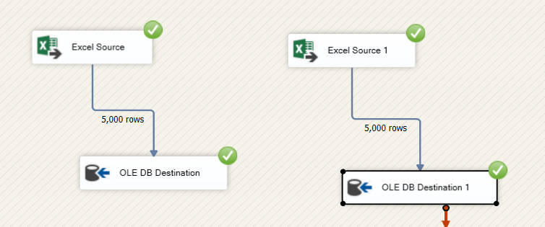
Loading data into SSMS USING SSIS: -

Slide 12
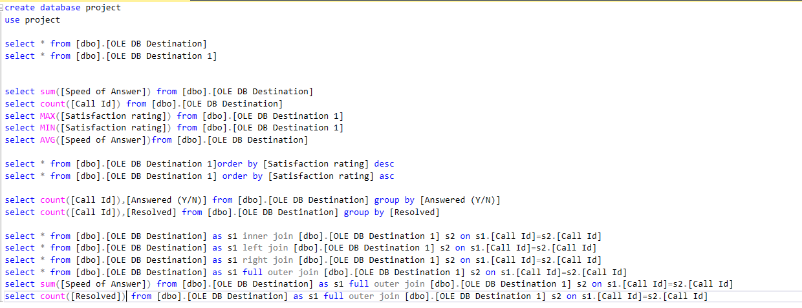
ETL process in SSMS: -

Slide 13
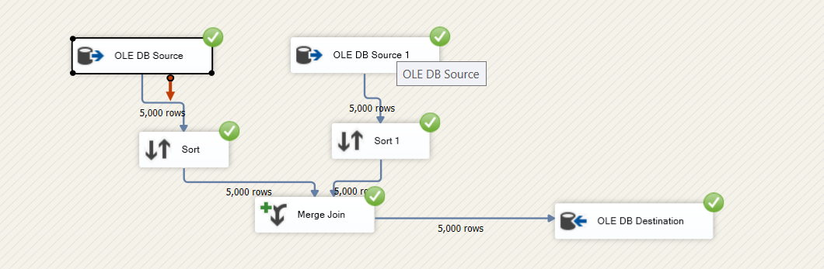
Merging 2 tables in SSIS

Slide 14
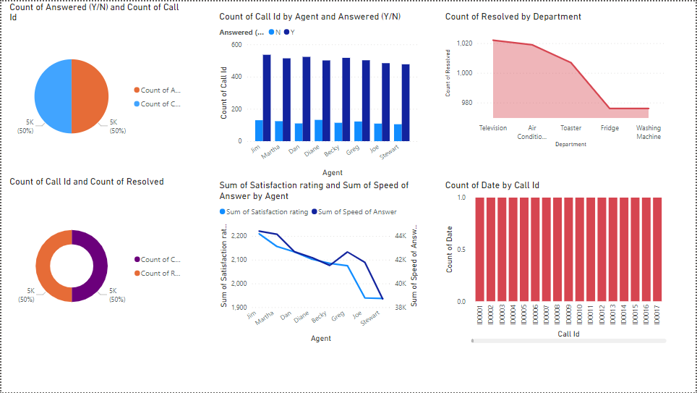
Visualization in Power Bi

Slide 15
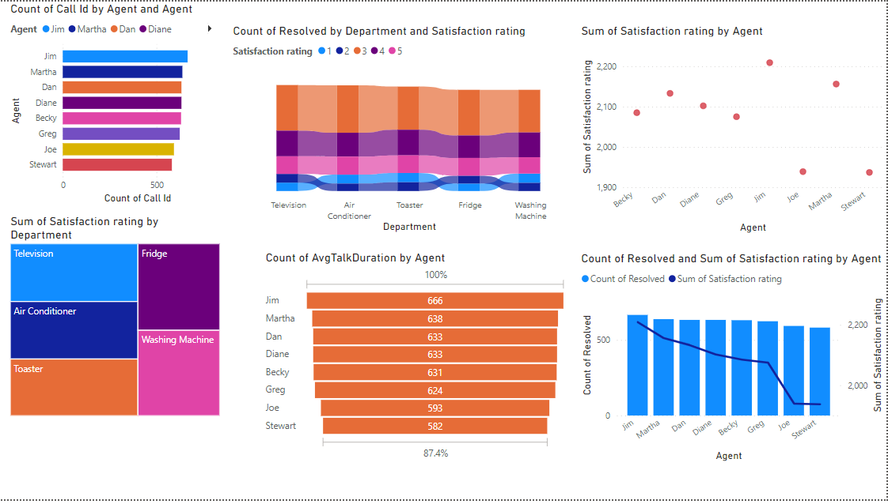

Slide 16
Conclusion and Future works
The key benefits of using a data warehouse for call center analytics include improved customer service, increased operational efficiency, better resource management, and enhanced decision-making capabilities
To further improve the effectiveness of a data warehouse for call center analytics, organizations can explore additional tools and techniques
Developing a data warehouse for call center analytics and customer service improvement is an ongoing process that requires careful planning, implementation, and maintenance
By using the right tools and techniques, organizations can gain valuable insights and improve their call center operations, leading to better customer experiences and business outcomes

Slide 17
References
[1] Author Sompong Wongvigram “Analysis of Call-Center Operation Data Using Role Hierarchy Miner” published year 2015, method Machine Learning Algorithm (Hierarchy Miner).
[2] Author Islamabad “Intelligent decision making and planning for call center” published year 2019, method Customer Service Reprehensive (CSR) and Machine Learning Algorithm (k-Means Clustering).
[3] Author Betul Karakus “Call Center performance Evaluate Using Big Data Analysis” published year 2016, method Machine Learning Algorithm (Cosine and n-gram) and Hadoop.
[4] Author Patcharin Panpanich “Analysis of Handover of Work in Call Center using Social Network Process Mining Technique” published year 2015, method Handover of Work (Social Network Miner).
[5] Author Leonardo O. Iheme “Machine Learning-based Silence Detection in Call Center Telephone Conversation” published year 2019, method Machine Learning Algorithm (Clustering) and Deep Learning-Based applied to VAD.

